Slide 1
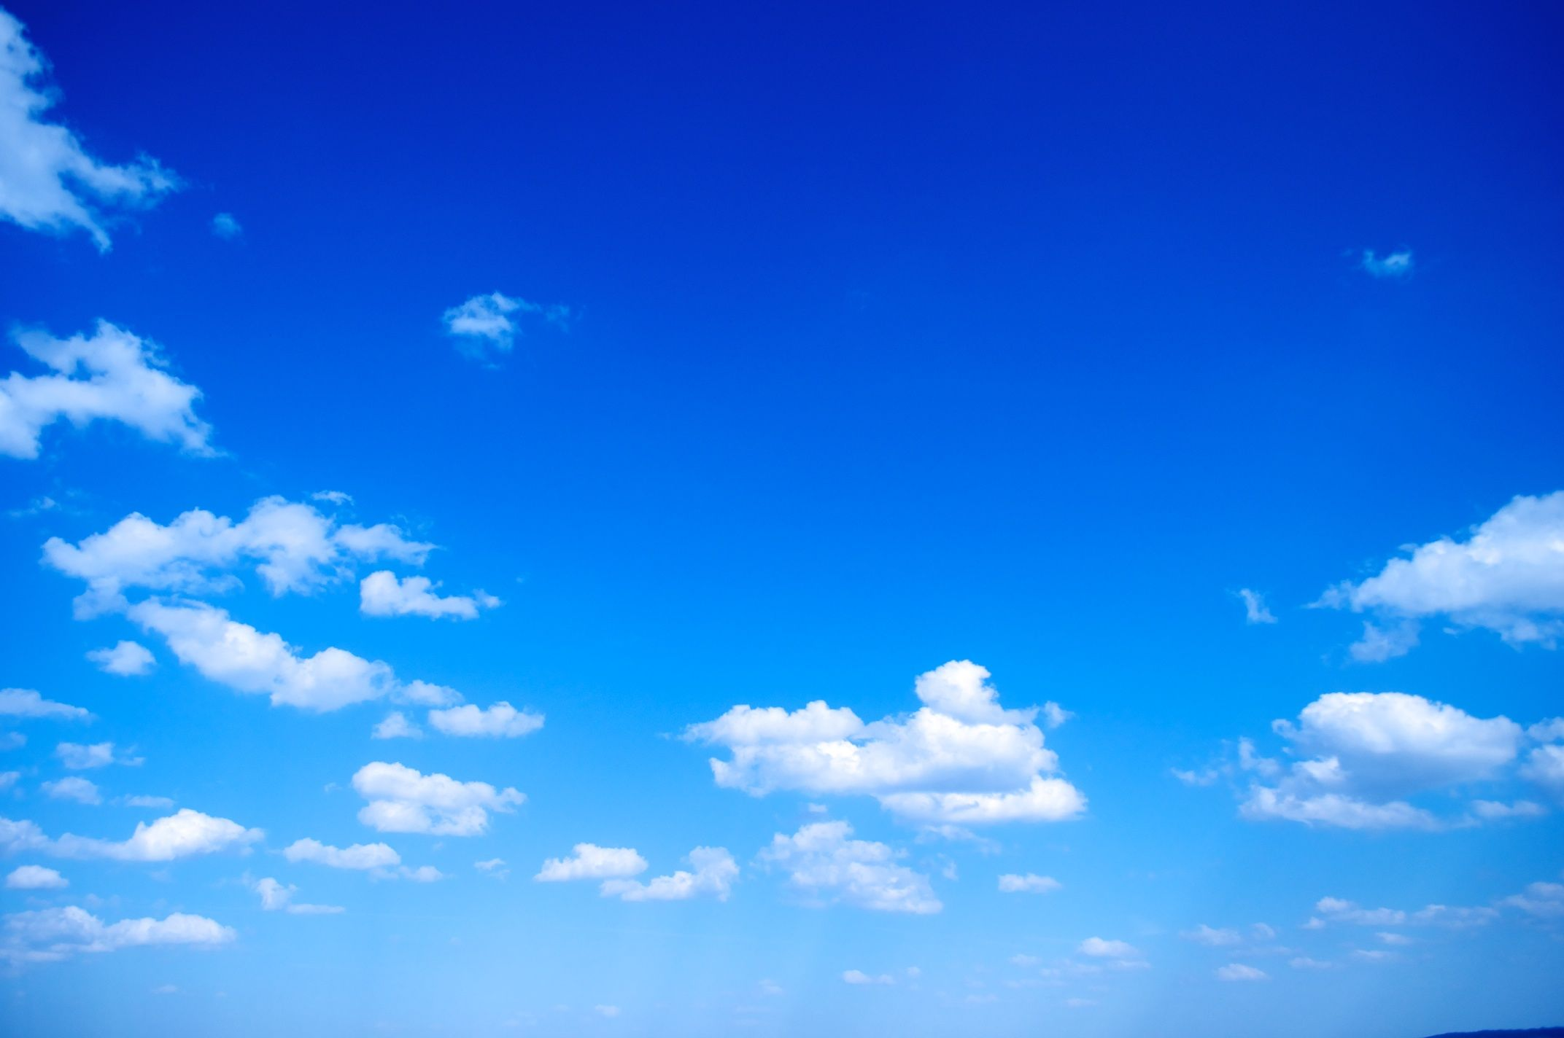
Why is the Sky Blue?
By: Nick Buccongello
Image: https://imagejournal.org/2008/03/17/north-and-south/blue-sky/

Slide 2
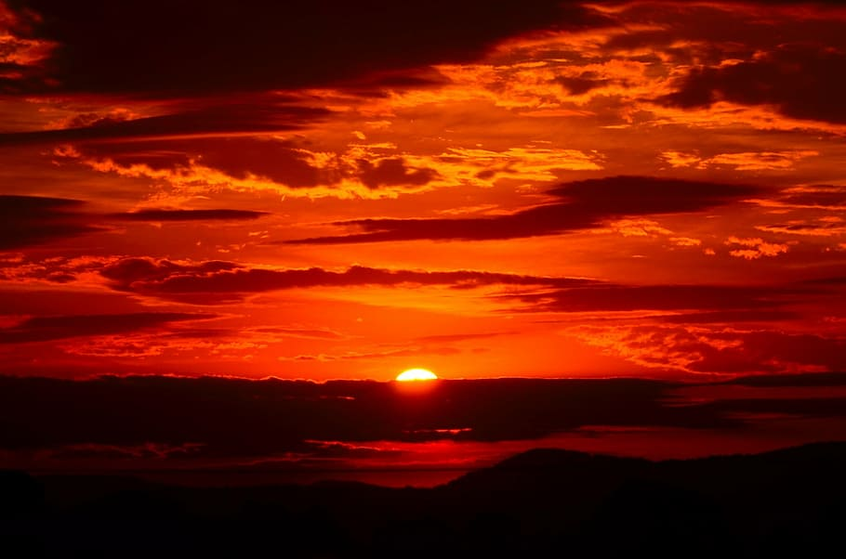
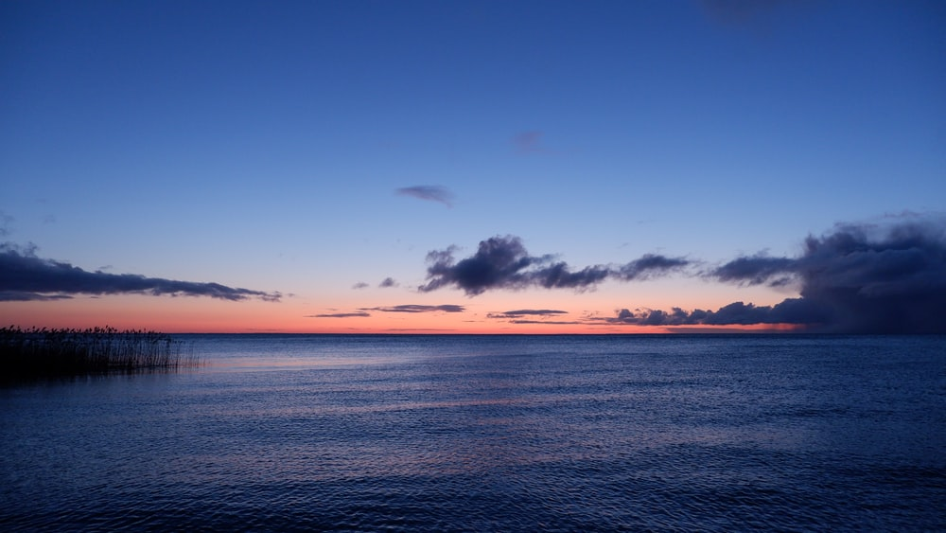
Is the Sky Blue?
Image: https://www.wallpaperflare.com/silhouette-of-hills-during-golden-hours-sunset-red-sky-fiery-wallpaper-zglxz
Image: https://unsplash.com/photos/JxGwZlL4yU4

Slide 3
Light Scattering
- Charged particle interacts with EM wave
- Particle experiences a force to change its motion according to EM wave frequency
- Particle becomes a source of EM radiation of the same frequency
- Incident light scattered in all directions
https://www.britannica.com/science/electromagnetic-radiation/Continuous-spectra-of-electromagnetic-radiation

Slide 4
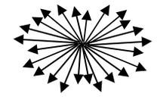

Rayleigh SCattering
-$I= I_{0}\frac{8π^{4}Nα^{2}}{λ^{4}R^{2}}(1+\cos^{2}θ)$
(N = # of scatterers, α = polarizability, R = distance from scatterer, $I_{0}$= Incident Light intensity)
- Occurs in smaller particles (ie. gas molecules)
- Predominantly scatters blue light
- Scattering in all directions
- I α $\frac{1}{λ^{4}}$
- Blue light is scattered 9.8x more than red
B
B
B
B
Images: https://physicsopenlab.org/2019/07/10/light-scattering/
https://www.sciencedirect.com/topics/engineering/mie-scattering-theory
http://hyperphysics.phy-astr.gsu.edu/hbase/atmos/blusky.html#c3

Slide 5

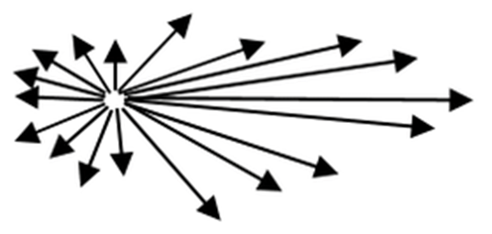
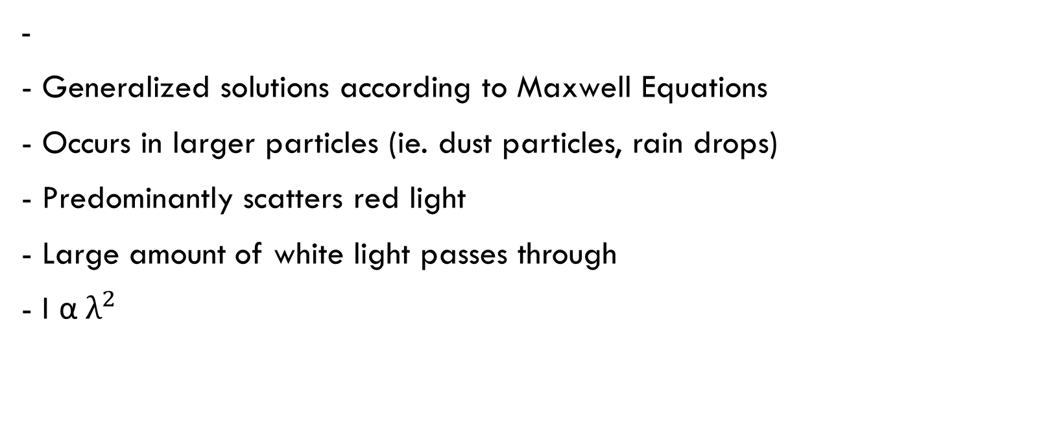
Mei Scattering
-
- Generalized solutions according to Maxwell Equations
- Occurs in larger particles (ie. dust particles, rain drops)
- Predominantly scatters red light
- Large amount of white light passes through
- I α $λ^{2}$
R
W
R
W
R
Lockwood D.J. (2016) Rayleigh and Mie Scattering. In: Luo M.R. (eds) Encyclopedia of Color Science and Technology. Springer, New York, NY. https://doi.org/10.1007/978-1-4419-8071-7_218

Slide 6
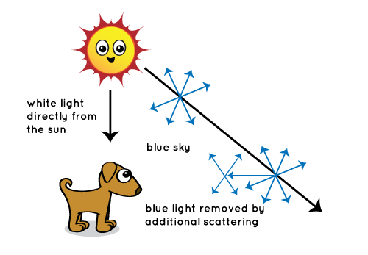
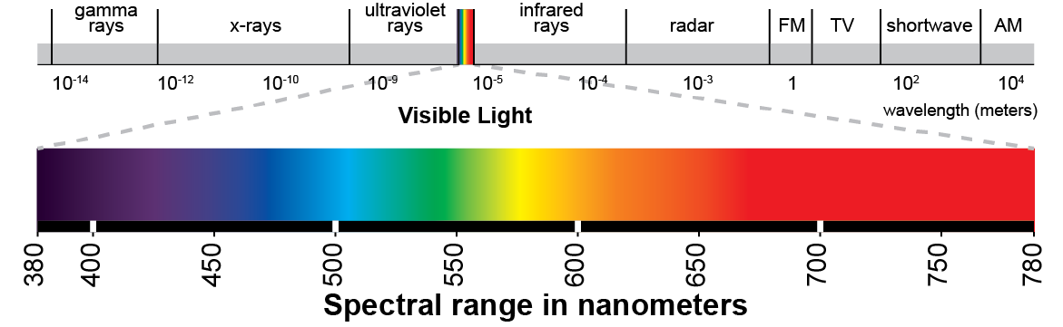

Why is the Sky Blue?
- Sunlight reaches atmosphere and is scattered
- I α $\frac{1}{λ^{4}}$ so Rayleigh dominates
https://eyehortilux.com/grow-lighting-guide/measuring-light-for-plant-growth/evaluating-quality-grow-light-using-spectrum/visible-light-spectrum/
https://spaceplace.nasa.gov/blue-sky/en/

Slide 7
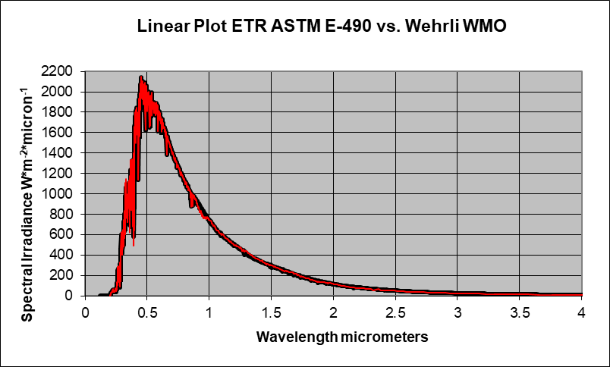
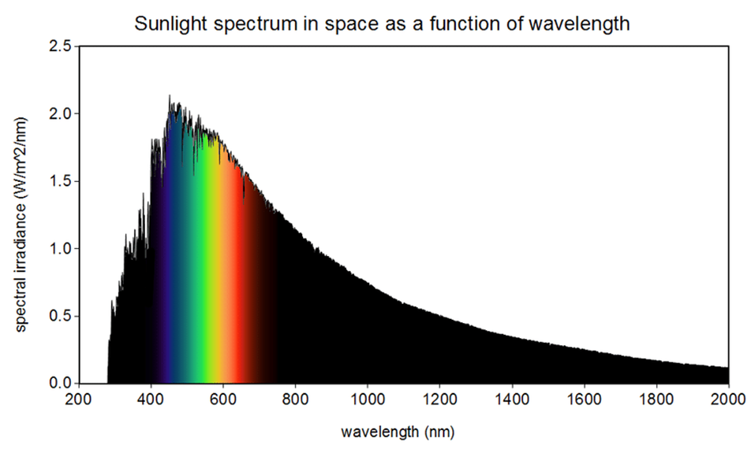
Why is the Sky Not Purple?
- Sunlight contains more blue light than any other colour
- Sun is not a perfect black body (T = 5700 K)
https://www.nrel.gov/grid/solar-resource/spectra-astm-e490.html

Slide 8


Why is the Sky Red at Sunset?
- Sunlight travels a longer distance through the atmosphere
- Therefore, more opportunities for light to scatter
- Strong Rayleigh scattering depletes blue light
- Weak Mei scattering allows red light to remain
https://www.pikpng.com/transpng/iiiwmmh/

Slide 9
The Sky at Sunset
Image: https://www.wallpaperflare.com/silhouette-of-hills-during-golden-hours-sunset-red-sky-fiery-wallpaper-zglxz
Image: https://unsplash.com/photos/JxGwZlL4yU4

Slide 10
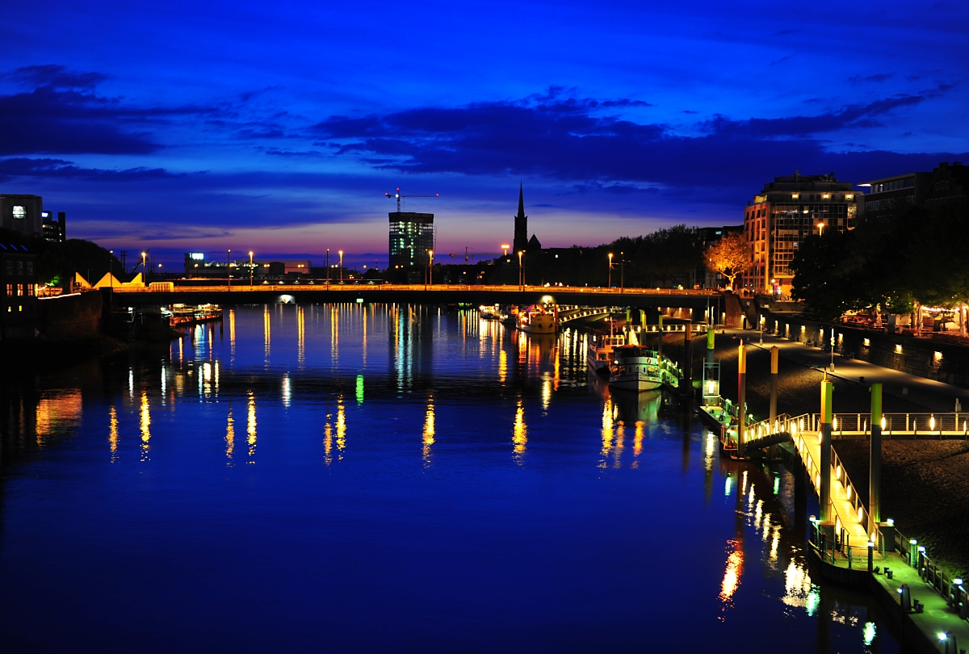
Chappuis Absorption
- Causes “blue hour” before sunrise and after sunset
- Ozone Chappuis bands absorb light between 500-700 (nm)
- Caused by photodissociation of ozone molecules
- Negligible effects at midday
Shaw, G. E. (1979). Atmospheric Ozone: Determination by Chappuis-Band Absorption, Journal of Applied Meteorology and Climatology, 18(10), 1335-1339. Retrieved Nov 9, 2021, from https://journals.ametsoc.org/view/journals/apme/18/10/1520-0450_1979_018_1335_aodbcb_2_0_co_2.xml
E. O. Hulburt, "Explanation of the Brightness and Color of the Sky, Particularly the Twilight Sky," J. Opt. Soc. Am. 43, 113-118 (1953)
Image: http://www.travel-photos.net/about/blue_sky/

Slide 11
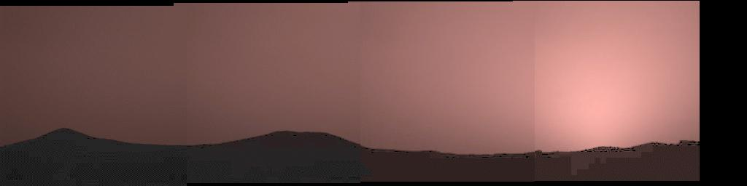
Why is Mars’ Sky Red?
- Mars’ Atmosphere is less than 1% of Earth’s atmosphere by volume
- Very little Rayleigh scattering
Image: https://mars.nasa.gov/MPF/science/clouds.html
Image: https://www.esa.int/ESA_Multimedia/Images/2018/04/Comparing_the_atmospheres_of_Mars_and_Earth#:~:text=Mars%20is%20about%20half%20the,rich%20in%20nitrogen%20and%20oxygen.

Slide 12
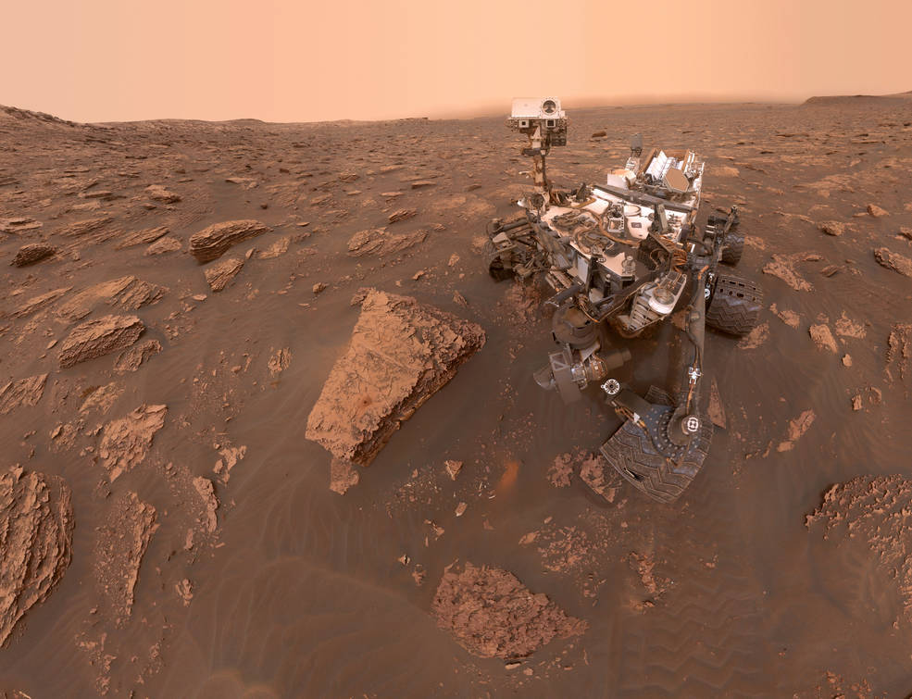
Why is Mars’ Sky Red?
- Dust storms and dust devils lift 2e+11 kg of dust into the atmosphere every year
- Mie scattering is prevalent
- Iron-oxide is present in the dust, contributing to red colour
https://marsed.asu.edu/mep/dust
Image: https://www.nasa.gov/feature/goddard/2018/curiosity-photos-show-martian-dust-storm-growing

Slide 13
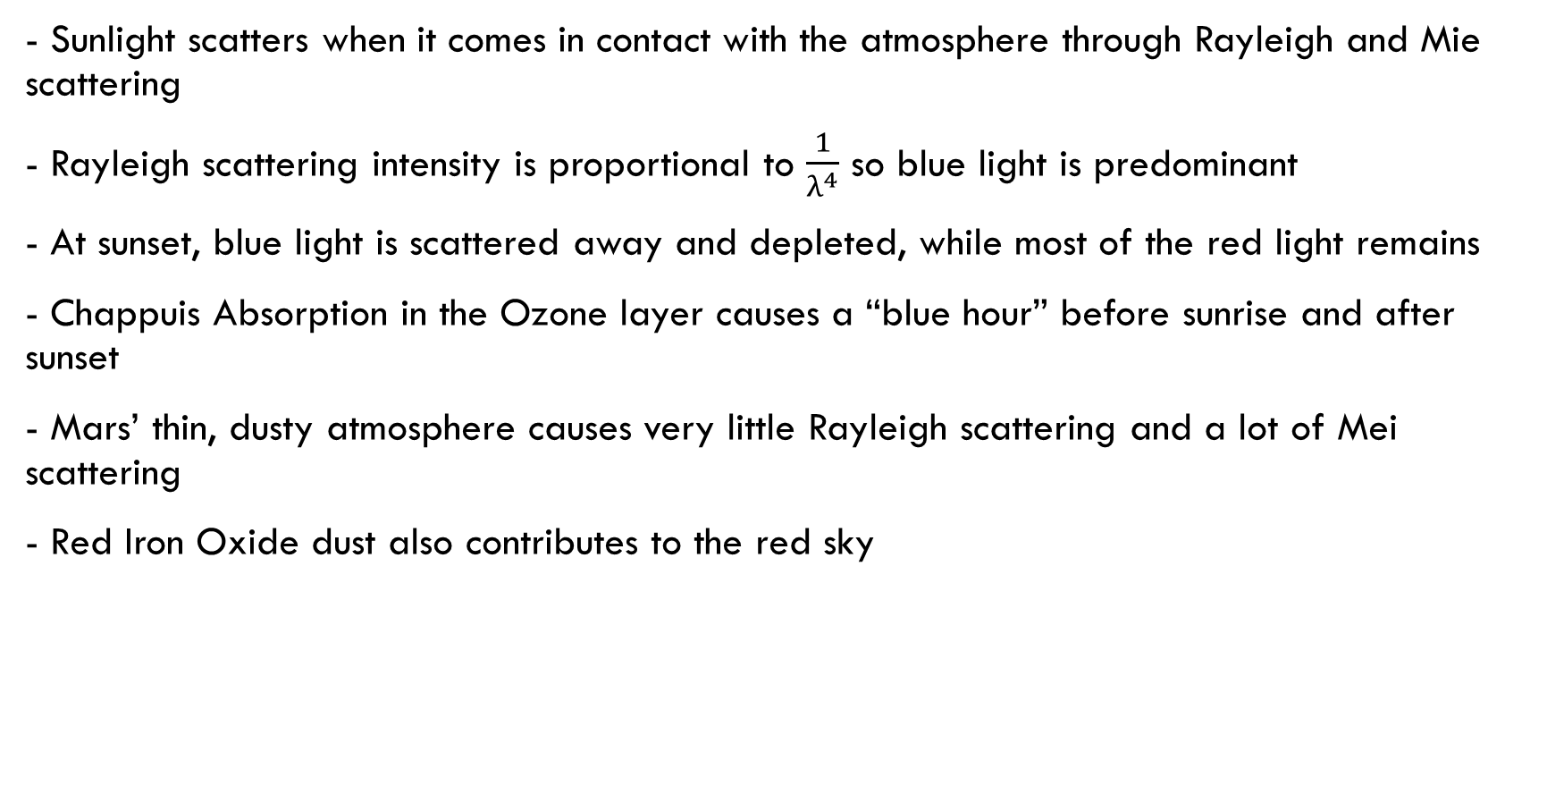
Conclusion
- Sunlight scatters when it comes in contact with the atmosphere through Rayleigh and Mie scattering
- Rayleigh scattering intensity is proportional to $\frac{1}{λ^{4}}$ so blue light is predominant
- At sunset, blue light is scattered away and depleted, while most of the red light remains
- Chappuis Absorption in the Ozone layer causes a “blue hour” before sunrise and after sunset
- Mars’ thin, dusty atmosphere causes very little Rayleigh scattering and a lot of Mei scattering
- Red Iron Oxide dust also contributes to the red sky

